Slide 1


From Requirements
to Verified Software
A formal verification pipeline for ambiguity, consistency and conflict detection across SDLC documents
Proof-guided SDLC verification
Rohit Patil
Swaraj Jahirabadkar
Sia Mittal Jay Shorey
Mentor – Anand Yeolekar
Notes:
[Sources] Visual on this slide was generated with Microsoft Copilot. [/Sources]

Slide 2
The big picture: idea to dependable software
SDLC verification is the trust layer between intent and implementation.
1
2
3
4
5
Idea
Requirements
Verification
Build
Software
Business intent
What the system must do
Are requirements clear, complete and consistent?
Human or AI implementation
Reliable behavior
If the specification is wrong, faster implementation only delivers the wrong system faster.

Slide 3
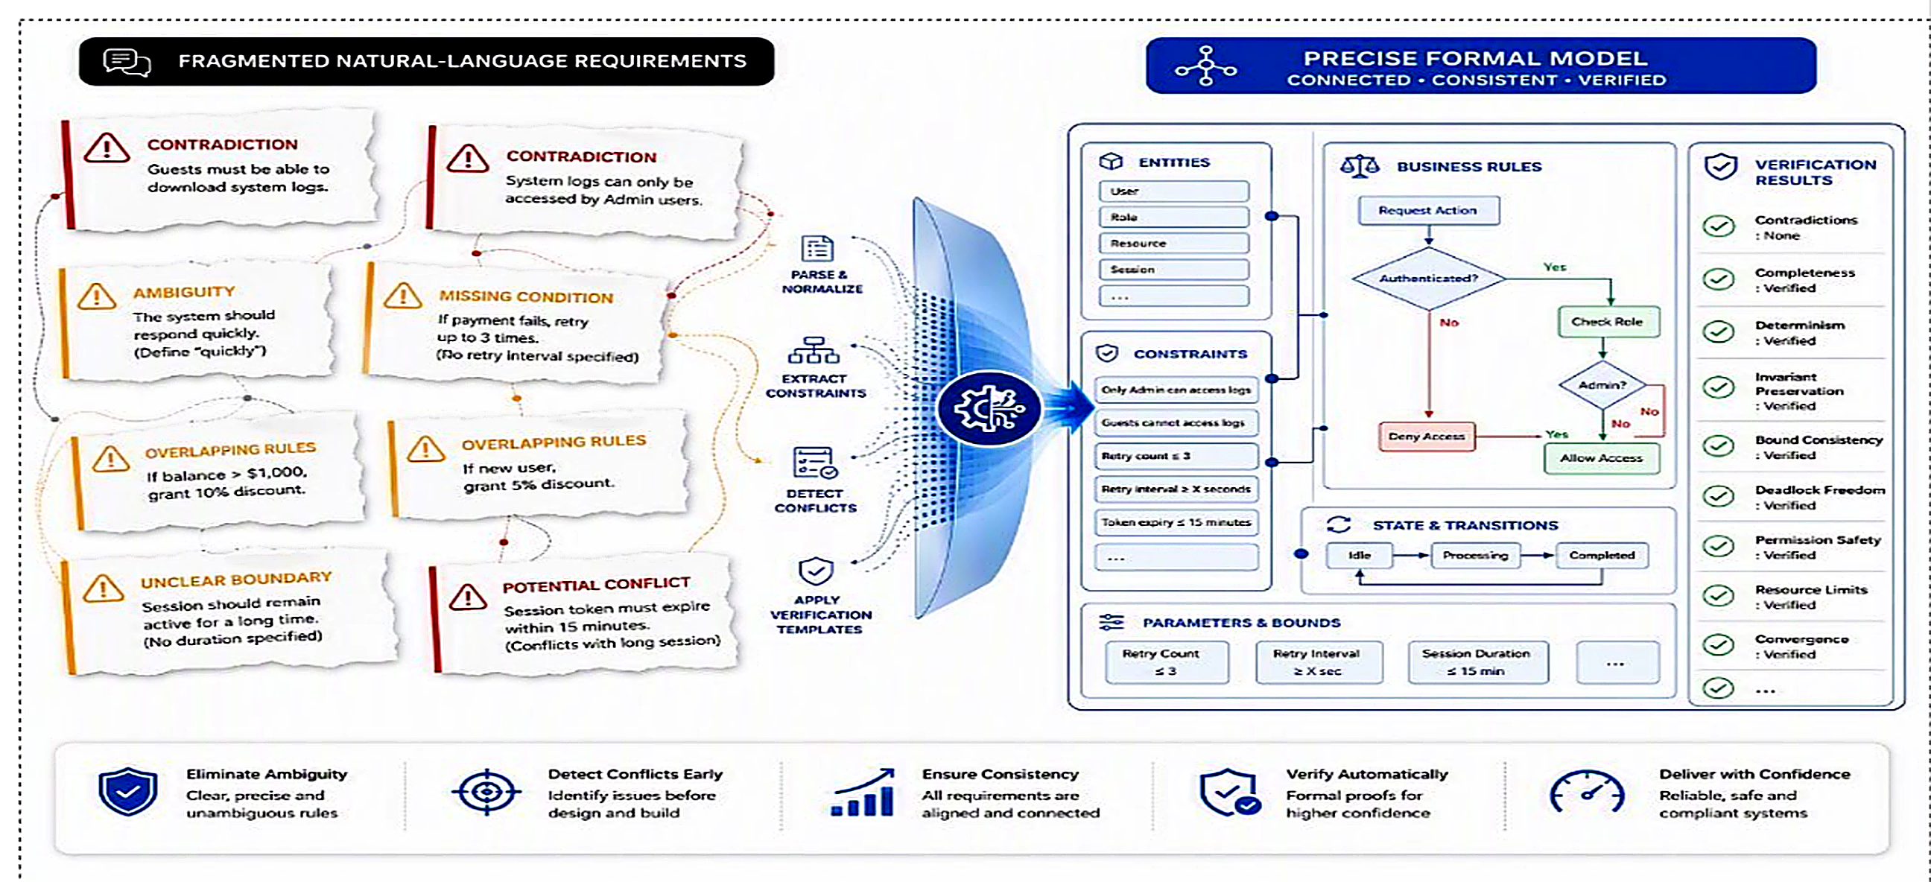
The big picture: idea to dependable software

Slide 4
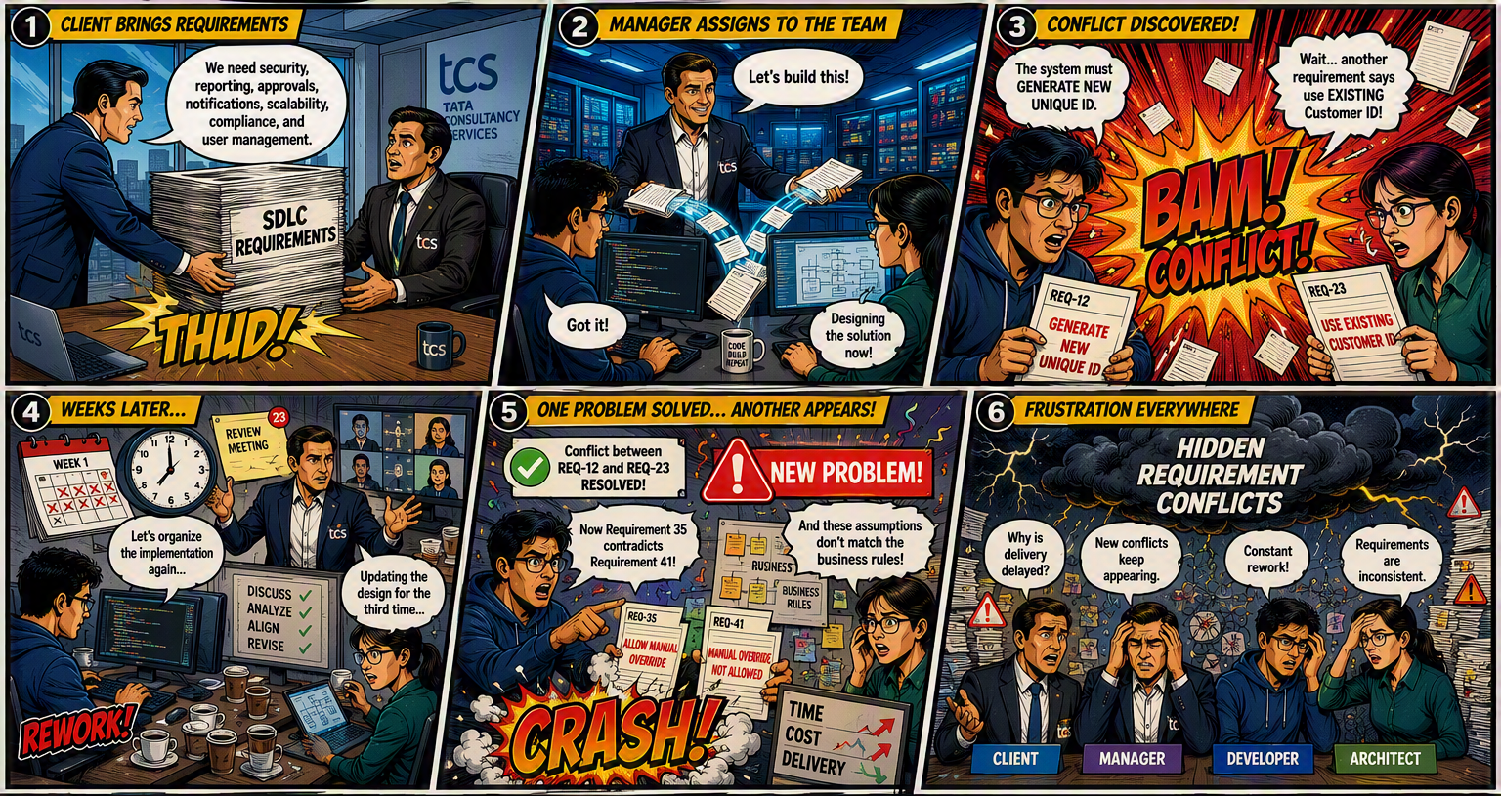
Use Case

Slide 5
The problem: natural-language requirements are not proof-ready
Documents can look reasonable while hiding defects that only appear when requirements interact.
Ambiguity
“Quickly”, “adequate”, “normally”
No single executable meaning
Contradiction
Guest access vs. admin-only access
Both cannot hold together
Missing coverage
Rules for below 18°C and above 24°C
No behavior for the middle range
Cross-rule effects
Retries, timeouts and end-to-end limits
Individually valid, globally infeasible
The hardest defects are not spelling errors. They are logical interactions across requirements.

Slide 6
Why this problem is worth solving
Requirement defects propagate downstream, where correction becomes slower, costlier and harder to explain.
Business & product
Misaligned intent
Unclear acceptance criteria
Architecture & engineering
Conflicting design choices
Rework and unstable interfaces
Testing & assurance
Unclear oracle
Incomplete traceability
AI-assisted delivery
Plausible but incorrect output
Low confidence in generated artifacts
Who has this problem?
Business analysts
Product owners
Architects
Developers
Test teams
Auditors
AI agents

Slide 7
Who has the problem?
The same unclear or inconsistent specification creates different problems at every stage of the SDLC.
STAKEHOLDER
PROBLEM EXPERIENCED
LEVEL OF IMPACT
Business analysts
and product owners
Requirements may not accurately represent the intended business behavior.
1
Incorrect scope and disputed acceptance criteria
Architects
Conflicting constraints can produce incompatible design decisions.
Unstable architecture and redesign
2
Developers and
AI coding agents
The implementation must choose between multiple plausible interpretations.
3
Inconsistent or incorrect behavior
The defect begins in the requirements, but the impact is distributed across the entire delivery lifecycle.
TCS confidential
tcs

Slide 8



Who has the problem?
The same unclear or inconsistent specification creates different problems at every stage of the SDLC.
STAKEHOLDER
PROBLEM EXPERIENCED
LEVEL OF IMPACT
1
Business analysts
and product owners
Requirements may not accurately represent
the intended business behavior.
Incorrect scope and disputed acceptance criteria
2
Architects
Conflicting constraints can produce
incompatible design decisions.
DESIGN IMPACT
Unstable architecture and redesign
3
Developers and
AI coding agents
The implementation must choose between
multiple plausible interpretations.
IMPLEMENTATION IMPACT
Inconsistent or incorrect behavior
The defect begins in the requirements, but the impact is distributed across the entire delivery lifecycle.
Notes:
[Sources] - Visual on this slide was generated with Microsoft Copilot. [/Sources]

Slide 9
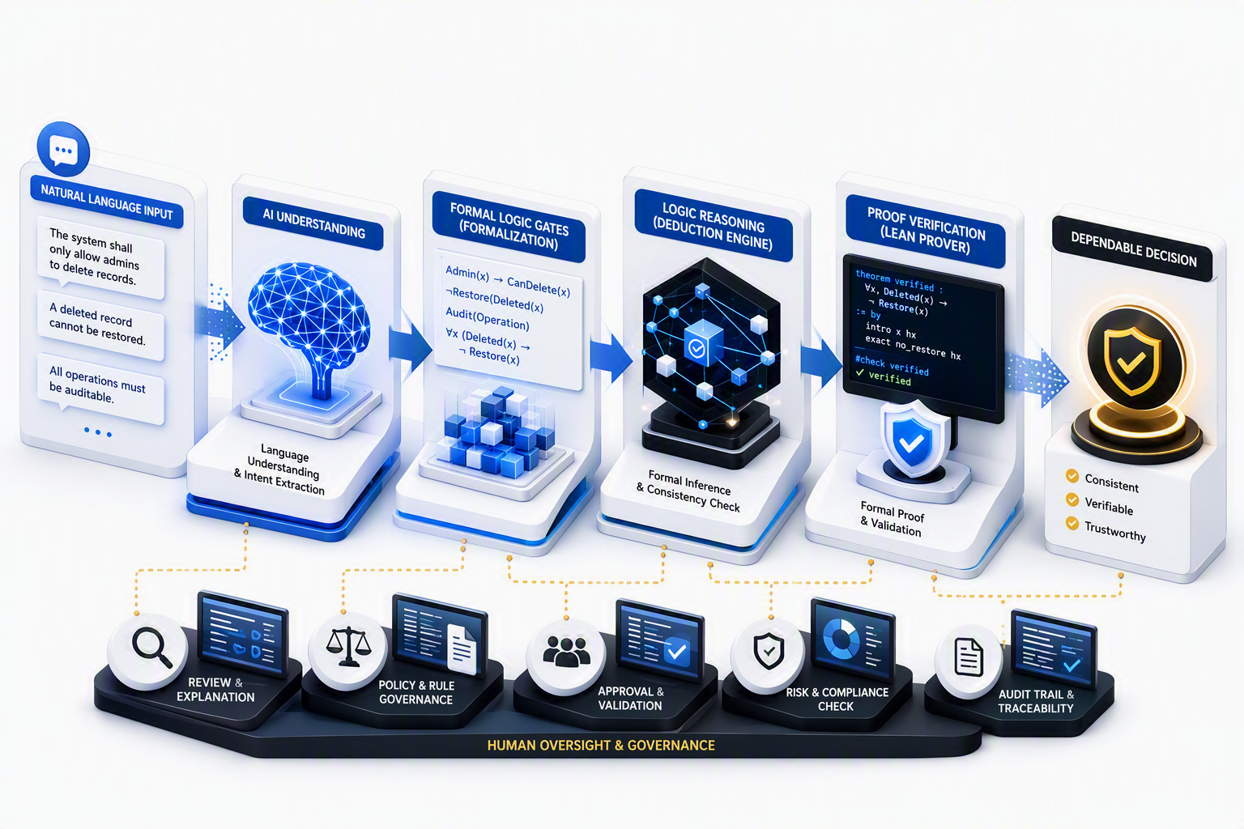
Why convert requirements into formal language?
Formalization turns interpretation into explicit objects that can be checked mechanically.
Explicit semantics
Predicates, quantifiers, states, bounds and actions are visible.
Machine-checkable claims
A prover validates whether conclusions follow from premises.
Counterexamples and witnesses
Failures can point to a conflicting pair, uncovered case or invalid transition.
Repeatability
The same requirement model produces the same verification obligation.
Notes:
[Sources] Visual on this slide was generated with Microsoft Copilot. [/Sources]

Slide 10
Our approach: constrain the LLM, let the prover decide
The LLM performs structured extraction and template filling, not unconstrained theorem invention.
1
2
3
4
5
6
Ingest
Clarify
Normalize
Formalize
Verify
Explain
SRS / SDLC document
Direct ambiguity extraction
Canonical requirement IR
Lean + first-order logic
Fixed theorem templates
Evidence-linked findings
Design principle: fixed schemas at runtime reduce generation freedom and improve consistency.

Slide 11
SDLC verification architecture
A controlled flow from natural-language requirements to executable verification and reviewer-ready evidence
1
2
3
4
5
6
7
8
SDLC input
Context + ambiguity extraction
Refined requirement
Refined context
Formal IR
Code generation
Same test cases
Report
SRS, BRD, policies and constraints
Build context, identify direct ambiguities and ask focused questions
Clarified, testable requirement statement
Decisions, definitions and source trace
Identical verification library applied to both paths
Finding
Lean IR
Lean code
Explanation
FOL IR
Z3 code
Action
Formal IR → executable Lean / Z3 encodings → shared test library
Design principle: fixed schemas at runtime reduce generation freedom and improve consistency.
TCS confidential
tcs

Slide 12
Architecture: major boxes and modules
A modular pipeline preserves traceability from source text to proof result.
A. Understand
B. Structure
C. Formalize
D. Verify
E. Present
Document parser
Requirement classifier
Lean preamble
15 theorem templates
Finding deduplication
Context builder
Pattern mapper
Lean generator
Lean compiler
Evidence trace
Ambiguity extractor
Canonical IR
FOL generator
FOL reasoner
Severity + explanation
Question + refinement
Entity / unit normalization
Assembler
Witness / conflict mapper
UI / report

Slide 13
Step 1: find direct ambiguity before formalization
The system isolates uncertain language and asks focused questions without rewriting the author’s intent.
Input requirement
Ambiguity finding
Focused clarification
“The system shall respond quickly to critical requests.”
Term: “quickly”
Type: measurable threshold missing
Impact: acceptance cannot be tested
“What maximum response time applies to critical requests?”
Output of this stage
Refined requirement + unresolved ambiguity record + updated context + source trace
Scope choice: target direct, actionable ambiguities first rather than claiming complete natural-language understanding.

Slide 14
Step 2: formal representation and code generation
The refined requirement and context are converted into parallel Lean and FOL paths, then translated into executable verification code.
Refined inputs
Formal IR
Code generation
Refined requirement
Refined context
Definitions and bounds
Source trace
Lean IR
Typed predicates and proof obligations
Lean code
Theorem instances + fixed proofs
FOL IR
Predicates and quantified constraints
Z3 code
Constraints + solver assertions
TCS confidential
11
tcs

Slide 15
Step 3: apply the same verification test cases
Both generated code paths evaluate the same requirement properties, keeping the meaning of each test consistent across Lean and Z3.
Generated code
Shared verification library
Verification evidence
Consistency
Can all selected requirements hold together?
Lean: proof success or unresolved obligation
Z3: SAT, UNSAT, model, or counterexample
Evidence remains linked to requirement IDs
Lean code
Conflict
Do premises imply a contradiction?
Z3 code
Coverage
Is any input, state, or boundary unhandled?
Behavior
Are outputs deterministic and transitions safe?
TCS confidential
12
tcs

Slide 16
Step 4: translate verification evidence into an actionable report
Technical proof and solver outputs are converted into reviewer-ready findings without losing traceability to the source requirements.
Verification evidence
Evidence interpretation
Report
Classify the result
Map technical evidence to affected requirements
Convert proof details into clear reviewer language
Preserve source trace
Lean proof status
Z3 solver status
Witness or counterexample
Requirement IDs and source text
Finding
What defect or verified property was identified?
Explanation
Why the result follows and which evidence supports it
Action
Clarify, revise, accept, prioritize, or rerun
TCS confidential
13
tcs

Slide 17
Step 2: dual formalization with Lean and first-order logic
Two complementary representations support executable proof and semantic cross-checking.
Canonical requirement IR
Lean representation
Actor
Trigger / guard
Action / effect
Object
Modality
Bounds and units
Exceptions
Source evidence
Typed predicates, states, transitions and fixed proof obligations.
Lean checks whether the proof term is valid.
Unified finding
Conflict type
Requirement IDs
Witness or counterexample
Proof / solver status
Explanation for reviewer
FOL representation
Predicates, quantifiers and logical constraints.
FOL supports satisfiability and semantic comparison.

Slide 18
Step 3: fixed verification templates
The LLM selects a theorem type and fills premises. The proof structure stays controlled.
Consistency
Rule quality
State & time
Coverage & limits
Behavior
Pairwise conflict
Global satisfiability
Minimal unsat core
Vacuity
Determinism
Redundancy
Invariant conflict
Deadlock
Cyclic sequencing
Recoverability
Range conflict
Partition gap
Resource overcommitment
Separation of duty
Convergence / oscillation
A successful conflict proof means the instantiated premises jointly imply False.

Slide 19
Example: from two requirements to a machine-checked contradiction
The result is tied to explicit premises, not to the model’s confidence.
R1
P := GuestCanDownloadLogs
hPos : P -- from R1
hNeg : ¬ P -- from R2
theorem pairwise_conflict : False :=
by
exact hNeg hPos
Guest users must have access to download system log files.
Verification result
Conflict confirmed
Evidence: R1 + R2
Reason: P and ¬P
Outcome: model is inconsistent
R2
System log files can only be accessed by authenticated Admin users.
Lean verifies the proof; the application explains the defect in requirement-review language.

Slide 20
Demo: reviewer journey through the web application
Replace the placeholders below with screenshots from the current UI before presenting.
SCREENSHOT
SCREENSHOT
SCREENSHOT
1. Upload document
2. Review ambiguities
3. Inspect formalization
SCREENSHOT
SCREENSHOT
SCREENSHOT
4. Run verification
5. Open finding evidence
6. Export report

Slide 21
What the verification results tell the reviewer
Every check should translate into a concrete decision, not just “pass” or “fail”.
Lean / solver outcome
Meaning
Reviewer action
Conflict proved
Requirements cannot hold together
Revise one or add priority / scope
Satisfying witness found
At least one model satisfies the selected set
Keep witness as evidence
Vacuity proved
A rule’s trigger is unreachable
Remove or repair dead rule
Coverage witness found
An input or state is unhandled
Add missing behavior
Cycle / deadlock found
System can enter a non-progressing loop or state
Change ordering or recovery rules
Proof not established
Insufficient facts, wrong mapping or property may not hold
Return to extraction and inspect premises

Slide 22
Strengths
Trustworthy Dual-Path​ Verification Framework​
Actionable Counterexamples Shows exact conditions where requirements conflict
Controlled LLM Dependency Formal engines validate LLM-generated representations
Automated Refinement Loop Verification failures help refine unclear requirements
Cost-Efficient & Scalable Generic LLMs + fast automated verification
Verification using Lean for proof-based reasoning Z3 for constraint solving

Slide 23
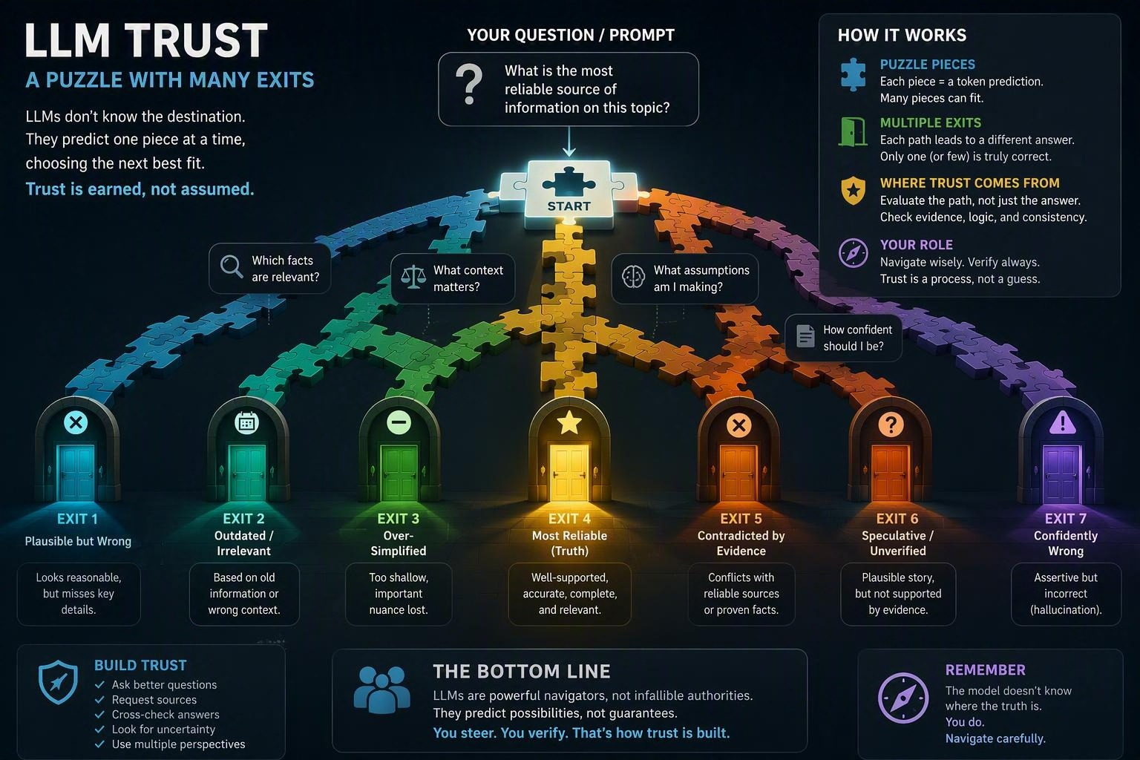

Slide 24
Future direction: formal verification as a trust layer for LLM systems
The same pattern can validate generated reasoning, decisions and transformations beyond SDLC documents.
LLM output verification
Reasoning consistency
Agent guardrails
Domain libraries
Learning loop
Later optimization
Reduce latency and bring ondevice capabilities using seq to seq approach.
Convert critical claims into formal obligations before acceptance.
Check whether conclusions logically follow from extracted premises.
Verify plans against policies, permissions and resource limits.
Add reusable theorem templates for finance, safety, operations and compliance.
Use failed proofs to improve schemas, extraction prompts and test cases.

Slide 25
Make requirements
provable before making
software executable.
Clear intent. Structured formalization. Machine-checked evidence.
Questions & discussion

Slide 26
Banking Requirements Verification Platform
A Bank Dhan Dhana Dhan Bank wants to build a Requirements Verification Platform for business analysts, architects, testers, and auditors. The application will capture business, functional, non-functional, and regulatory requirements for banking systems. It will automatically verify ambiguous, consistency and conflicts across requirements, design documents, test cases, and policies. The platform will detect conflicts, ambiguities, duplicates, and missing dependencies using LLM-based analysis. The goal is to build an LLM-driven application builder that prevents requirement inconsistencies and ensures high-quality, audit-ready banking documentation throughout the SDLC.

Slide 27
